Slide 1
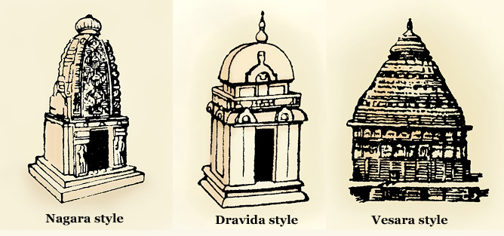

Slide 2
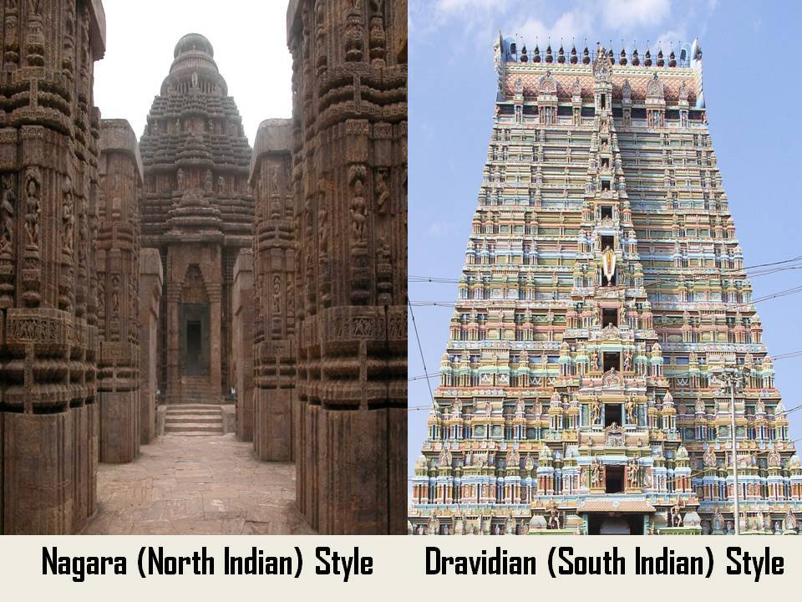

Slide 3
Later Cholas or Imperial Cholas
Art & Architecture
Middle of the 9th Century the Cholas emerged
Vijayalaya (850-871AD) Founder of the later cholas
Cholas ruled the lengthiest reign.
Cholas continued and developed the art and architecture of Pallavas
They spent major income of the state to the development of art and architecture.
Architecture of the Cholas classified into three stages
1. Early Chola temples: 850-985 AD-Vijayalaya chola to Aditya
2. Middle Chola temples: 985-1070 AD- Rajaraja I and Rajendra I
3. Later Chola temples: 1070-1250 AD- Kulothunga I, Rajaraja II and Kullothunga III.

Slide 4
Early Chola temples (Vijayalaya chola to Aditya)
Main features
Stones used for the construction of the temples
Small in size and most of them structural temples
Vijayalayasolisvaram temple atNarttamalai great example of structural temple which built by Vijayala Chola.
he constructed this temple for the memory of his victory over Mutharayas of Tanjore.
Square Garbhagraha is generally found in the temples, rarely it is circular
Temples are surrounded by a wall with Gopura in front
Sub shrines dedicated to pairava or minor gods.
There is no separate shrine for devi

Slide 5
Major Temples of this period
Siva Temple at Kovilpatti, Thoothukudi dist
Ayyanarkovil and Muckundesvara Temples at Kudumbalur, Pudukkottai dist
Sundaresvara Temple, Tirukkattutalai, Pudukkottai dist
Koranganatha Temple, Srinivasanallur, Trichy dist
Mahalingaswami Temple, Tiruvidaimarudur, Tanjore dist

Slide 6
Middle Chola temples
Rajaraja I and Rajendra I
Constructed medium size and big structural temple
Tiruvalisvaram temple at Brahmadesam in Tirunelveli dist. Great example for medium size temple of middle cholas.
Vaidyanatha temple at Tirumalavadi, twin temples of Siva and Vishnu at Dadapuram in South Arcot district also medium size temples of middle Cholas.
Maturity of the Cholas temple architecture was found in two great temples constructed in Tanjore and Gangaikonda Cholapuram.

Slide 7
Greatest landmark in the history of South Indian Architecture is Brahadeswarar Temple at Tanjore which known as Big Temple or Periya Kovil, Peruvudaiyar Kovil, Raja Rajeswara Temple and Rajarajeswaram.
It has many architectural significance which built by Rajaraja I. initiated around in 1003 AD and completed in 1010 A.D
This is the largest and tallest temple in Tamil Nadu and one of the largest temples in India.
Temple tower is the tallest one which is 216 feet high (66mts). the kumbam in the tower weighs about 60 or 80 tonnes.
Unique feature - it is the only temple where in the Temple's tower's or Gopuram shadow does not appear on the ground at noon.

Slide 8
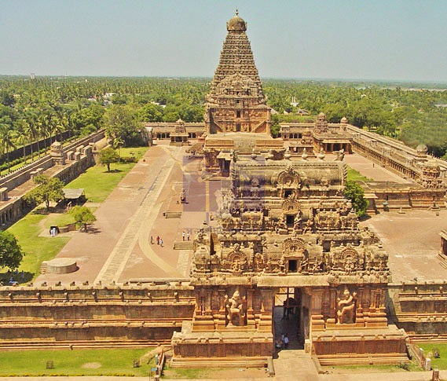
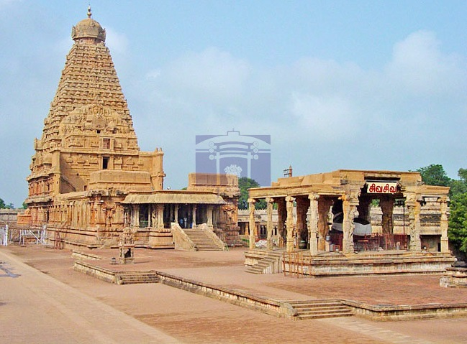

Slide 9
Temple Structure of Big temple
Garbha Graha
Ardha Mandapa
Maha Mandapa
Nandi Mandapa
Entrance Gopura
Constructed of granite
Top of the gopuram there is a huge stone with weight about 81 tones.
This temple completed its 1000 years in the year 2010

Slide 10
Big Statue of Nandi (Sacred Bull) carved out of a single rock at the entrance.
Monolithic Nandi 12 feet high, 19.5 feet long and 18.25 feet wide and weight about 20 tones
believed that stone was brought over from the bed of the River Narmada in the north for preparing Nandi statue.
It has been listed as a UNESCO World Heritage Site under the list of 'Great Living Chola Temples'.
Around 130,000 tons of granite was used in the formation of this temple.

Slide 11
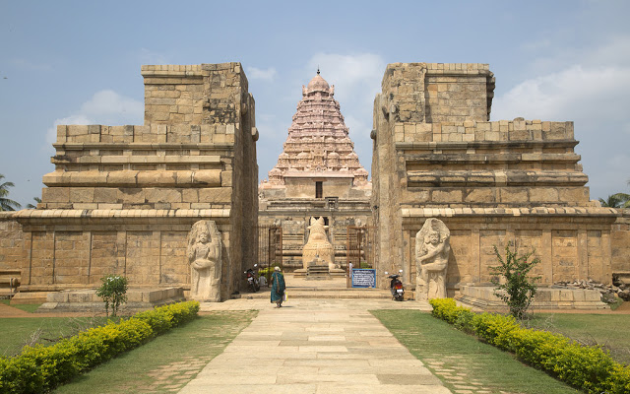
Gangaikonda Cholapuram
Rajendra I built from 1018 to 1033 AD
Within twenty years of the completion of the Great Big temple this temple was built.
Rajendra I built great city called Gangaikonda-Cholapuram due to memory of the conquest of the Gangetic plains.

Slide 12
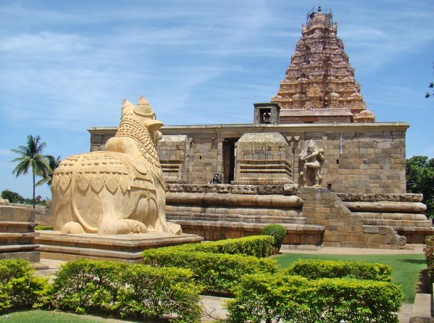
Name of the god is Gangaikondacholisvarar.
He shifted his capital from Tanjore to Gangaikonda-Cholapuram.
Height 185 feet
Gigantic dwarapalakas or gate-keepers also one of the feature of this temple.
It is more beautiful than temple at Tanjore.
Rajendra I donated huge amount for the construction of this temple.

Slide 13
Later Period 1070 -1250
size of the temples is small and resembled one another.
In 1113 AD Kulothunga I constructed Amirtaghatesvara temple at Melakkadambur, (Cuddalore dist) in the shape of a Chariot with two wheels on each side.
Vikrama Chola who ruled during this period donated considerable amount to improve and beauty of Chidambaram Temple.
This temple was fully remodelled and completed by his successor Kulottunga II.

Slide 14
Rajaraja II constructed the Siva Temple at Tirupandar and Darasuram in Tanjore in the early half of the 12th Century.
Kullothunga III was the last great builder among the Chola rulers.
He constructed Kamahareswara Temple at Tribhuvanam.
Sculpture on the Darasuram temple depicted stories from Periyapuranam.
Mural Painting or wall painting
Carnatic music and Bharatatyam dance
Temples constructed during the chola period acted as a sources of religious inspiration for the people.

Slide 15
Special Features of Chola Architecture
1. Cholas follows the Pallavas style of architecture.
2. Sanctum-Sanctorum or Garbhagraha of the Chola temples are both circular and square in size.
3. Upper side of the sanctum Vimanas are built.
4. Capstone or Shikhara
5. Vimana or Gopura
6. Mandapas
7. Praharas

